Slide 1
MPI Forum
Thoughts on How to Proceed
Notes:
Move to google

Slide 2
Observations
Number of plenary items is fairly low
Minor issues or errata only
Larger topics are repeated
Few new ideas being introduced
Major topics from MPI 3.0 still seem to be stuck
Fault tolerance, Endpoints, …
Little movements, same discussions over and over again
New major topics are not making enough progress
Sessions, PMPI2, …
People don’t have enough time
People have varying ideas – trying too much at one time?
Too much repition over and over again
Critical mass for new standard version missing
No gating issues, no time pressure
Consequently, time between standards is growing
Non US meetings often don’t meet quorum (3 of 4)
No ability to make “official” progress

Slide 3
Potential Dangers
MPI is seen as stagnant
No new versions for a long time
Not addressing new developments in other areas
Helps perpetuate the image that MPI doesn’t change
Can never be ready for new challenges
Can’t change to meet new needs
Reduced motivation
We are doing this “on the side”
Slow process can be frustrating
Long time between discussions reduces efficiency
If you only deal with a topic every three months, progress is hard
Changing people in the room makes it even harder
We have too many failed readings

Slide 4
The Forum has always moved slowly
Slow and Steady Wins the Race

Slide 5
…except when it doesn’t
Big data
Hadoop, Spark, etc.
MPI
Notes:
(and that’s what many/most vendors care about)
Many people don’t know about the new technologies

Slide 6
Two Questions
How can we pick up the pace?
Should we better serve new communities and how?

Slide 7
Two Questions
How can we pick up the pace?
Should we better serve new communities and how?

Slide 8
How do we move faster?

Slide 9
Perception by many: The MPI Forum is moving too slow

Slide 10
Obviously, we don’t want to move too fast

Slide 11
We want something between the two
Sweet spot

Slide 12
First ANgle
Meetings

Slide 13
We currently have 4 meetings a year
Q1 meeting
Q2 meeting
Q3 meeting
Q4 meeting

Slide 14
Should we have more?
Notes:
More meetings = more productivity.
Right now, meetings are too far apart, and people don’t do enough work between meetings.
The Forum is moving too slow.

Slide 15

Can (some of them) be non-physical?
Notes:
More physical meetings would be more travel cost, and probably no one can afford that
Maybe we can have a mix of physical and non-physical meetings (emphasize video for non-physical meetings – it really helps a lot).
Note: mixing non-physical attendance with a physical meeting is… sub-optimal. Hence, keeping the (almost) entirely physical meetings is a Good Thing.
Enough to talk even without having to vote

Slide 16
…but then who gets to vote?

Slide 17
Current voting rights based on physical attendance

Slide 18
Current voting rights based on physical attendance
That gets complicated if we have non-physical meetings

Slide 19
An alternative: voting eligibility based on (annual) dues
Makes it easy to determine who can vote
(especially over time)
Notes:
We are talking about a small amount
How to get a stable quorum
Decoupled from meeting fees, but could reduce meeting fees
Could help support academics – the MPI scholarship (e.g., waive meeting fees)

Slide 20
An alternative: voting eligibility based on (annual) dues
REMEMBER: This is about voting eligibility
Anyone can still attend MPI Forum meetings

Slide 21
Or perhaps a mix between the two
Notes:
The Forum has long-subscribed to the idea that physical attendance is significantly helpful in understanding what you are voting for.
The Forum wants organizations to have some “skin in the game” for voting.

Slide 22
Do we really want to allow voting at non-physical meetings?
Yes, let’s move forward
Requires decision on voting rights
Membership model
Fixed cricle
Carry forward from last meeting
No, too complicated, needs to be F2F
Can we make other progress?
“Pre-readings” to cut down on number of meetings
Plenary discussions
Example: weekly meetings with fixed topic schedule
WGs get tasked for particular meetings
Continuous feedback
Cut down on failed readings at F2F

Slide 23
Orthogonal: Working Groups
Most WGs meet bi-weekly
Should they (be encouraged to) meet weekly?
Keeps things more current
Easier to continue discussions
Fixed slot on calendars

Slide 24
SECOND ANGLE
Releases
- or -
Are we overdue?

Slide 25
Are We Overdue?
Long time since MPI 3.0
Even MPI 3.1 has been a while ago
Other standard – like OpenMP – are moving faster
Have several useful features in or likely in soon
Fixes to several areas
Fault behavior clarifications
Persistent collectives
Send cancel deprecation
COMM-DUP and info hints/assertions
Is this enough?
For an MPI 4.0 or MPI 3.5

Slide 26
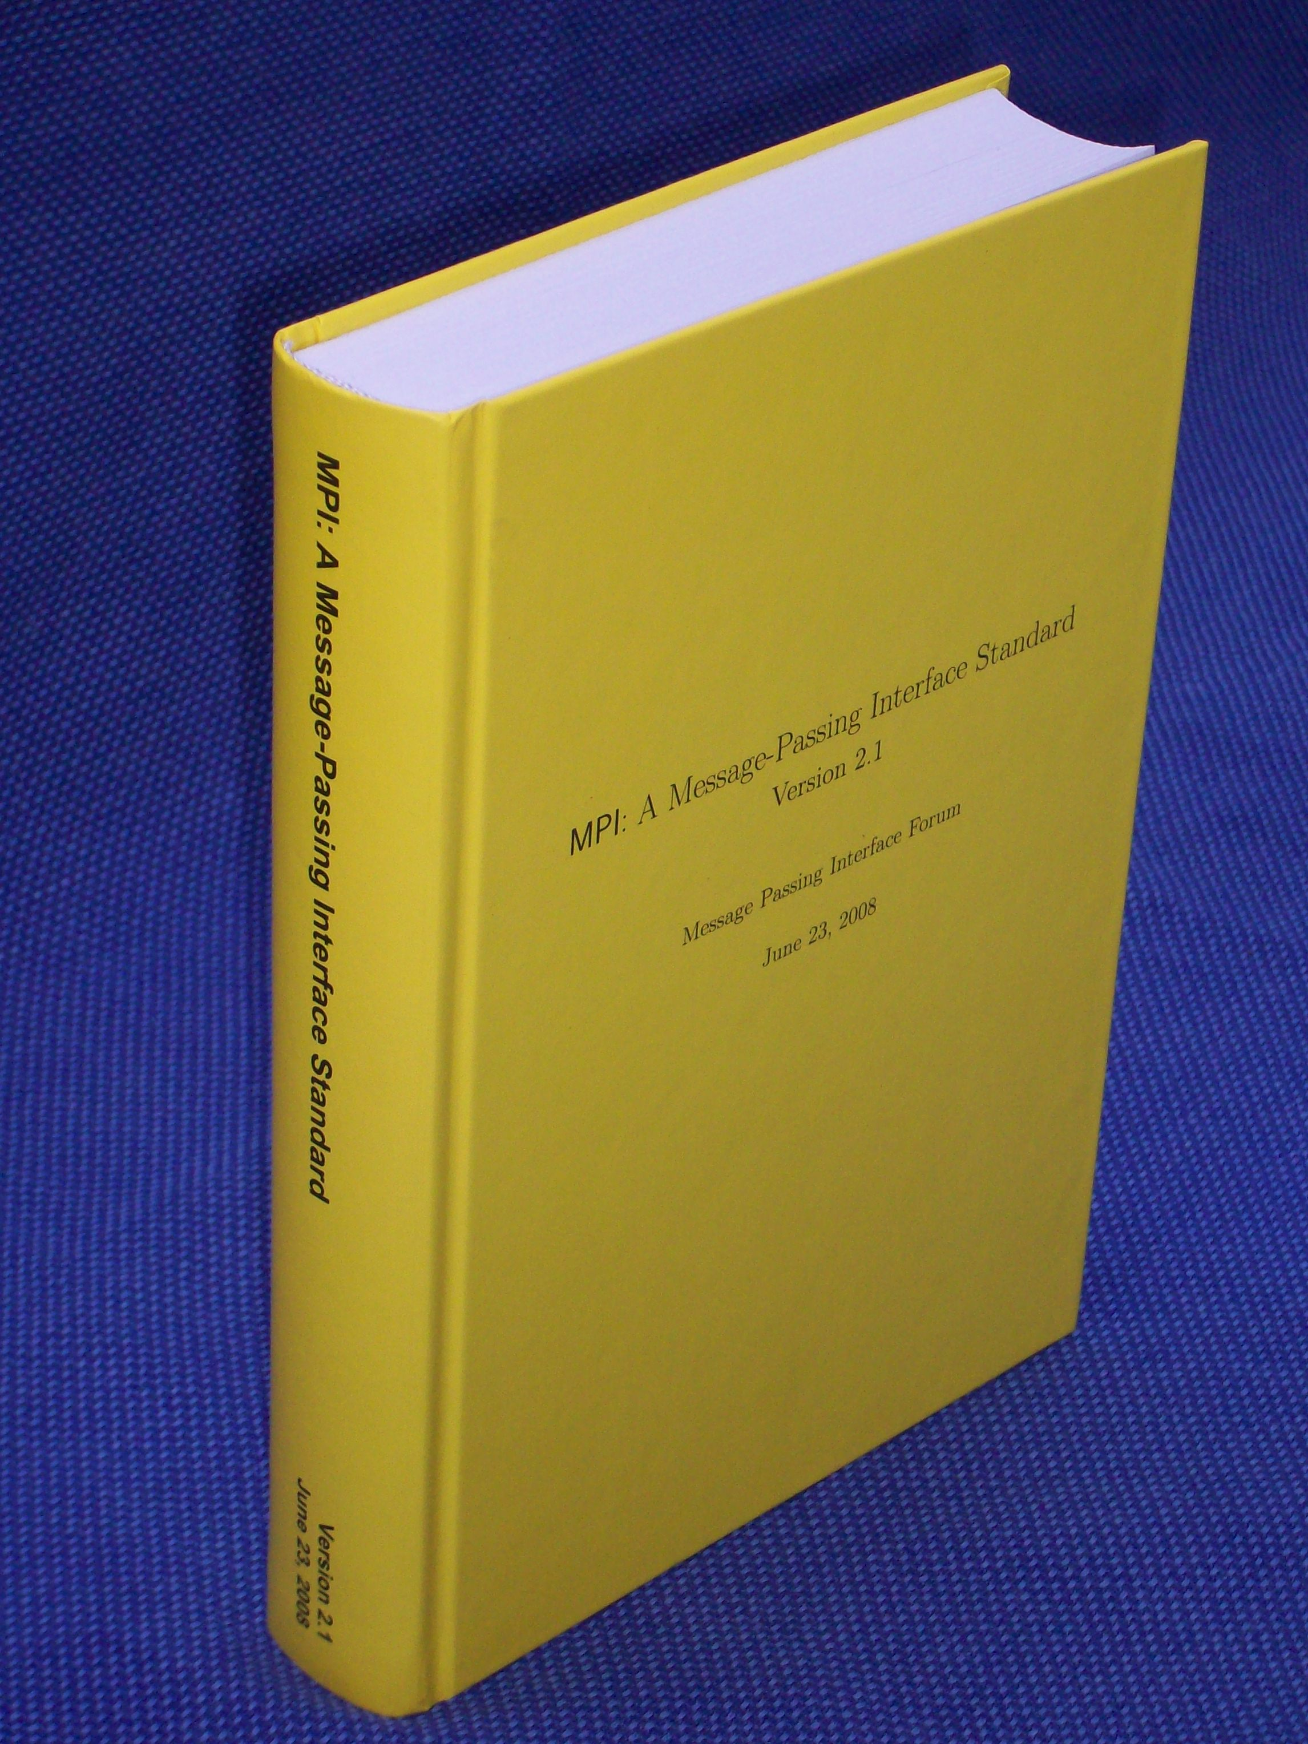
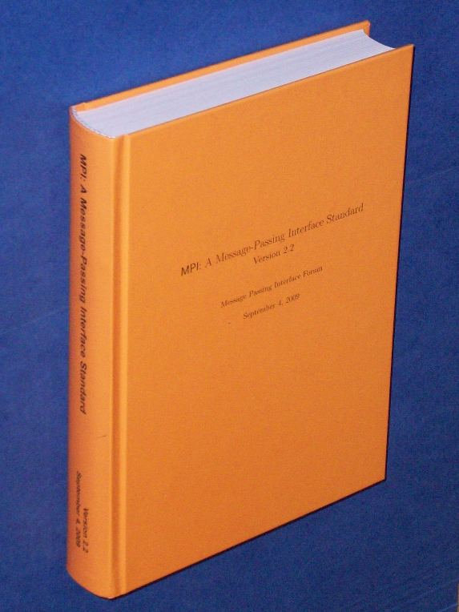
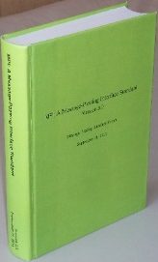
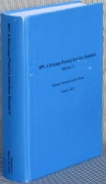
An Different View (Rolf’s Slide)
In HLRS’s many training courses, always people like to have MPI as a book!
MPI-2.1 (608 pages, 821g=29oz, June 23, 2008)
916 printed / 738 sold / 178 unsold
MPI-2.2 (647 pages, 840g=29.6oz, Sep 4, 2009)
921 printed / 900 sold / 21 unsold ☺ ☺
MPI-3.0 (852 pages, 1031g=36oz!!, Sep 21, 2012)
1055 printed / 969 sold / 86 unsold ☺
MPI-3.1 (868 pages, 1066g=38oz!!, June 4, 2015)
1040 printed / 487 sold (Sep 20, 2017) / 170 expected until end of 2018 / 383 unsold (still enough if MPI-4 is coming 2019/2020)

Slide 27
More Radical Changes
Pick next release date
Sets a deadline
Pick fixed release schedule
Sets deadlines
Regular progress
Adopt intermediate releases
Every year before SC we publish a draft standard
Based on features voted in
Independent of full standard releases
Needs new rules on what is a draft release!

Slide 28
THIRD ANGLE
Streamlining

Slide 29
Options: Clean-up & Streamlining
Declutter list of of WGs
Introduce mechanism for disbanding WGs
Require re-approval of WGs in regular intervals
Encourage better note taking
Used to be more common for WGs
Introduce for plenaries and in person WGs (?)
Enables others to follow items better
Delegate side documents to WGs
Can make changes on its own
Only re-publishing of document requires plenary vote
Even more drastic: re-publishing if no-one vetos
If this a candidate for phone meetings?

Slide 30
SUMMARY
How to Push MPI Forward?

Slide 31
How to Move Forward?
Get folks from new areas involved
Direct / Personal contacts
Give them a voice and listen to their needs
Increased meeting schedule
Add phone meetings to push forward proposals
Goal: reduce number of failed readings
Topics during phone meetings
At least readings and general discussions
Anything else needs change of voting eligibility
Increase WG schedule
Suggested interval weekly
Encourage better documentation

Slide 32
Summary
Does it make sense to have more meetings?
Especially if some of them don’t require travel?
If so, does this require changing voting eligibility rules
Based on dues?
Based on dues + physical attendance?
Other ways to reach a stable quorum?
Do we allow voting at non-physical meetings?
If so, what do we allow voting on?
If not, how do we get people to attend?
Weekly WG meetings
YES
YES
DEPENDS
PROBABLY NOT
MAYBE …?
CARRY FORWARD?
DEPENDS
ERRATA (?), SD(?) Suggestions?
DEPENDS

